Slide 1

Introduction
Project Goal: Enhance EIA.gov usability using AI and semantic web technologies.
Hackathon Focus: Security, responsibility, and accessibility.

Slide 2
CHALLENGE AND SITUTATION
Current State of EIA.gov: The website is not optimized for large language models (LLMs) like ChatGPT and Gemini.
User Shift: Users are increasingly relying on LLMs for information, leaving a gap in EIA’s data accessibility.
Opportunity for EIA: Aligning with EIA’s mission to provide accessible, high-quality data to the public by integrating LLM optimization.

Slide 3

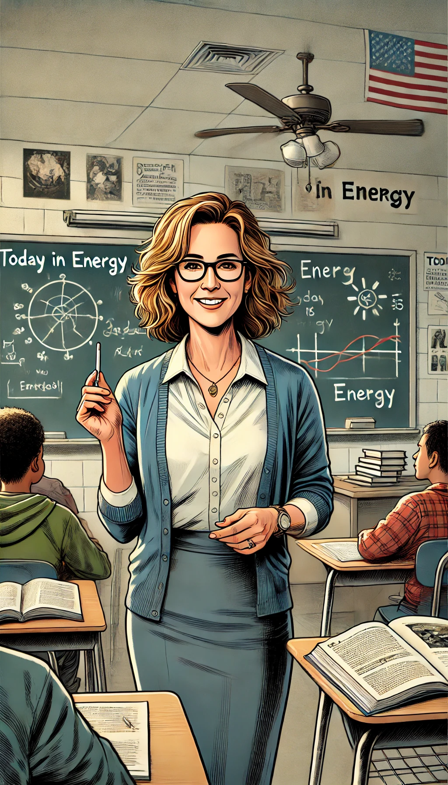

Andrea: Industry Economist
Ellen: High school teacher
Ian: Congressional staffer

Slide 4
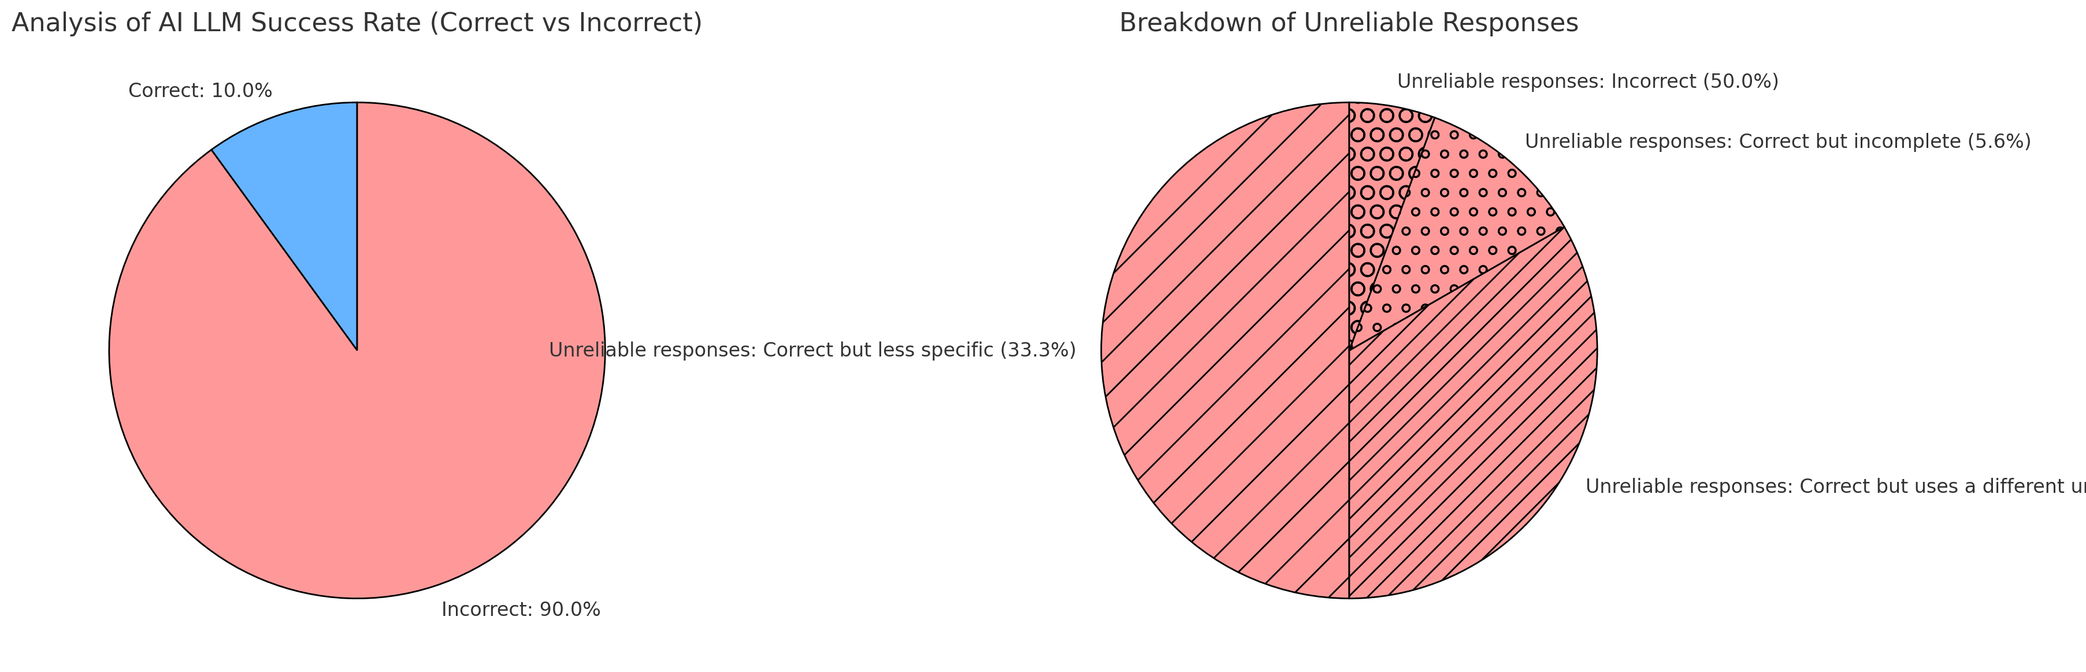
Data Analysis: As is state
Analysis of AI LLM Success Rate (Correct vs Incorrect):
Correct: 10.0%
Incorrect: 90.0%
Breakdown of Incorrect Responses:
Incorrect: 45.0%
Correct but less specific: 30.0%
Correct but uses a different unit of measurement: 10.0%

Slide 5
Data Approach
Data Analysis and User Interaction
We analyzed data from the EIA website, focusing on:
Natural gas spot prices in New England.
Electricity spot prices in various regions.
Renewable energy consumption statistics.
We used semantic web technologies to organize and enhance data accessibility.
Integrated AI and LLM to improve user interaction and provide more accurate and relevant information.

Slide 6
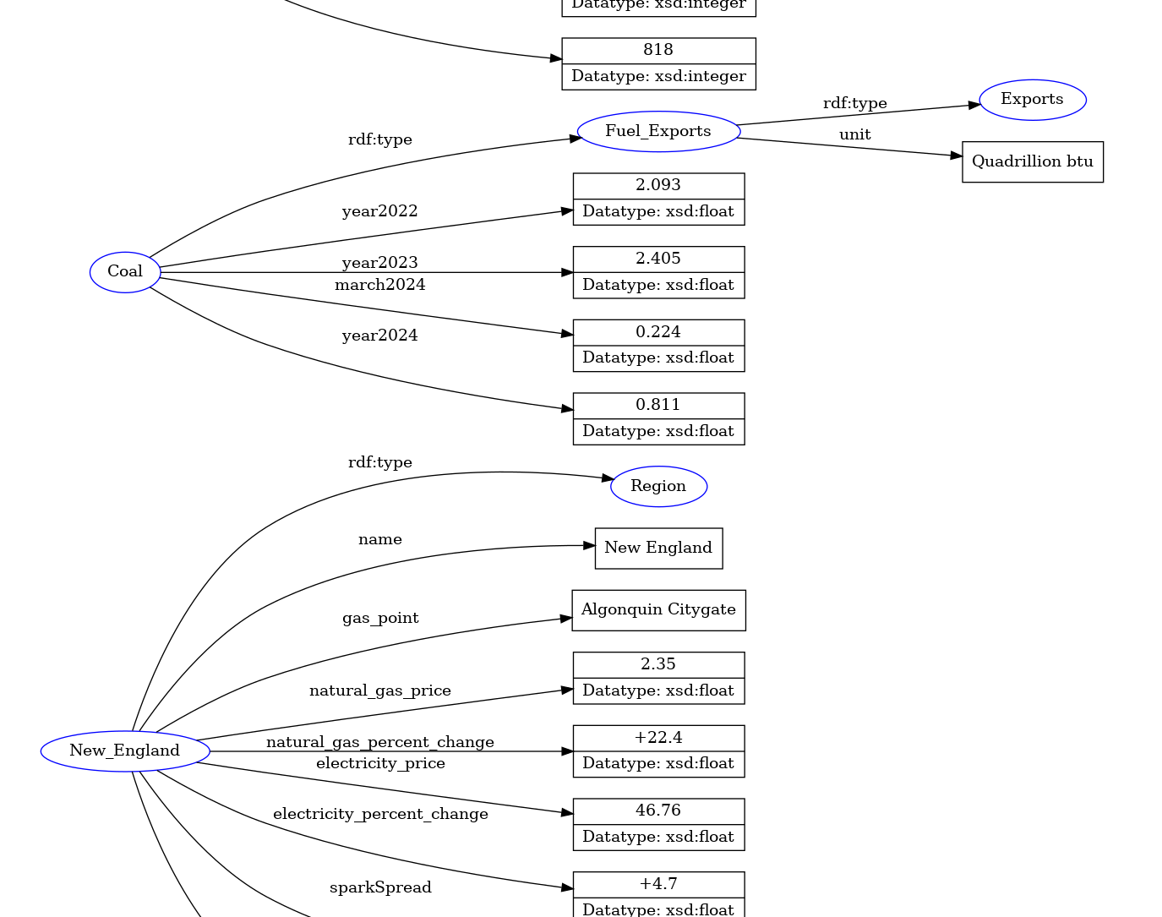
Knowledge Graph

Slide 7
Semantic Web and AI Integration
Semantic Web and AI Integration
Semantic web technologies and AI were used to create a comprehensive web graph.
Sparql
Blaze Graph
This combination provided better data interpretation and user interaction.

Slide 8
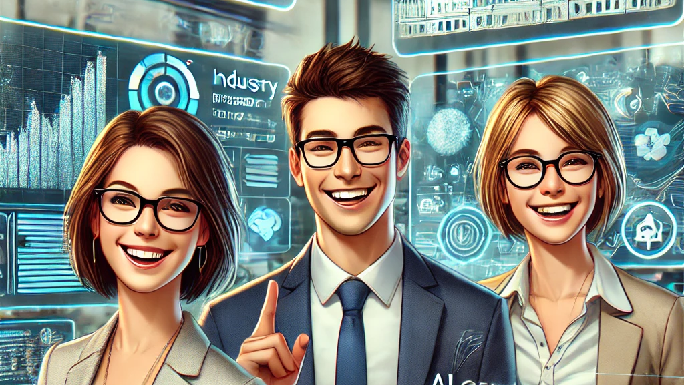
Results & Demo
Improved User Interaction
Andrea: Access to up-to-date market data and investment insights. For example, monitoring the natural gas spot price in New England and comparing it with historical data.
Ian: Quick and reliable information for policy decisions. For example, getting a summary of renewable energy consumption trends in the U.S. for the past five years.
Ellen: Simplified and educational content for teaching. For example, visualizing the changes in solar energy consumption from 2020 to 2023.

Slide 9



